Slide 1
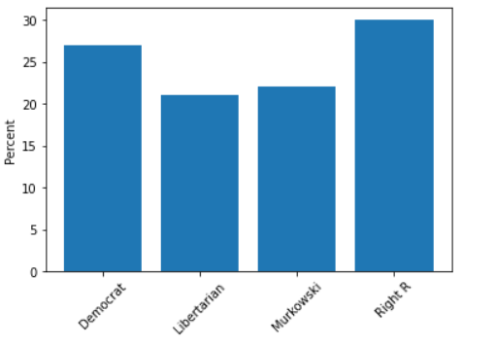
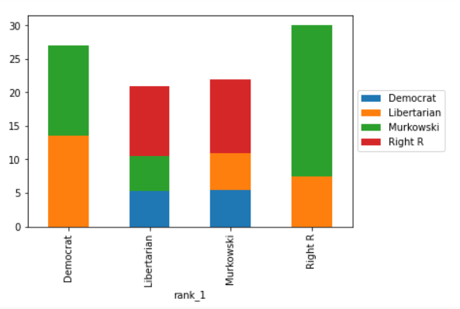
RCV Webapp UI Design - Setup | David Lichtman
Percents
Votes
✓
Step 1: Enter in names of the candidates and their first rank %, or number of first choices
A 20%
B 10% (checks if % with all candidates=100, if in percent mode)
C 30%
__
Step 2: Drag candidates into all of the likely orderings you can think of and give group %s, each group % must equal 100 (percent could also be # of votes, switchable, no restriction in that case)
candidates:
A
B
C
(From step 1)
Randomize
(Fine adjustment)
75
23
50
50
50
__
A
C
B
(Autogenerate random orderings and percentages option?)
A
B
(Doesn’t add up to 100)
A
B
Add another A? (on mouseover)
B
C
(5 allowed rankings/columns, arbitrary number of rows)
(Adds up to 100)
(Waiting for input)
C
(First column auto filled when line created, 1 row autogenerated for each candidate)
(Shift candidate name to left most open space if dropped into further right space)
Rank 1 Graph
X-Ray/On-Deck Graph

Slide 2
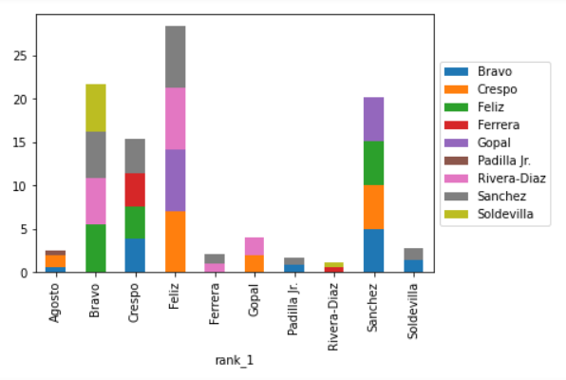
Rank 1 Graph
X-Ray/On-Deck Graph
(maybe have these be adjustable from dragging them, changes numbers in step 1, would have check that they add up to 100)
(Could drag to adjust, changes numbers in step 2, could check that each column still adds up to percents in step 1 and rank 1 graph)
(Could handle this as just x-ray graph, or add checkbox/switch between rank 1 and x-ray)
Simulate Runoff
Main difference between % and votes mode is that when you raise a percent other percents have to decrease, but not if you raise a number of votes
Should be able to zoom in to see/adjust smaller columns

Slide 3
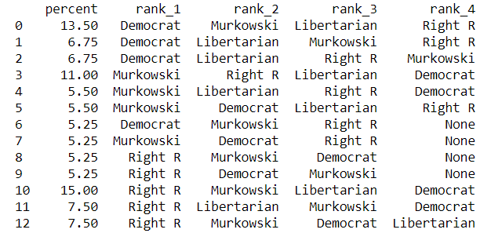

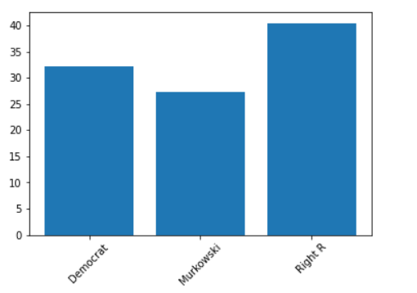
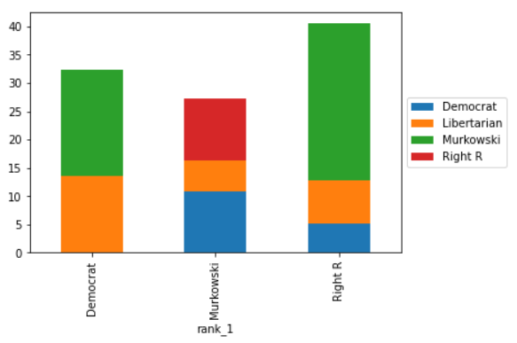
Webapp UI Design - Round Output
ROUND 1
[Candidate] was eliminated this round
[Eliminated Candidates] have been eliminated
Updated Full Ranking Table
Updated Candidate Percents
Updated Candidate Percent Bar Graph
Updated X-Ray Bar Graph
ROUND 2 to Final
[Repeat above features]

Slide 4
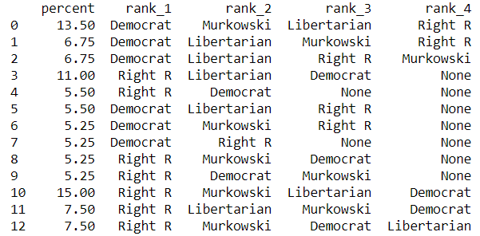


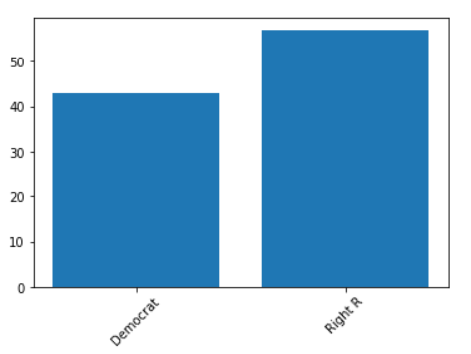
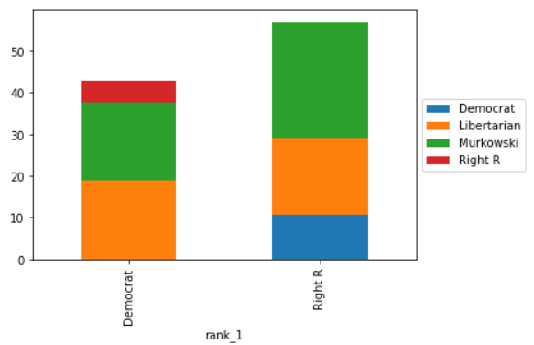
Webapp UI Design - Final Round Output
ROUND X
[Candidate] was eliminated this round
[Eliminated Candidates] have been eliminated
Updated Full Ranking Table
Updated Candidate Percents
Final Percent/Votes Bar Graph
Final X-Ray Bar Graph

Slide 5
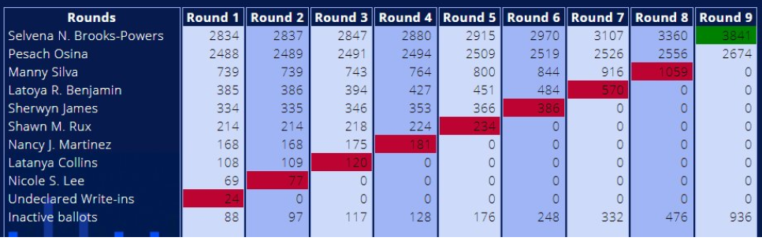
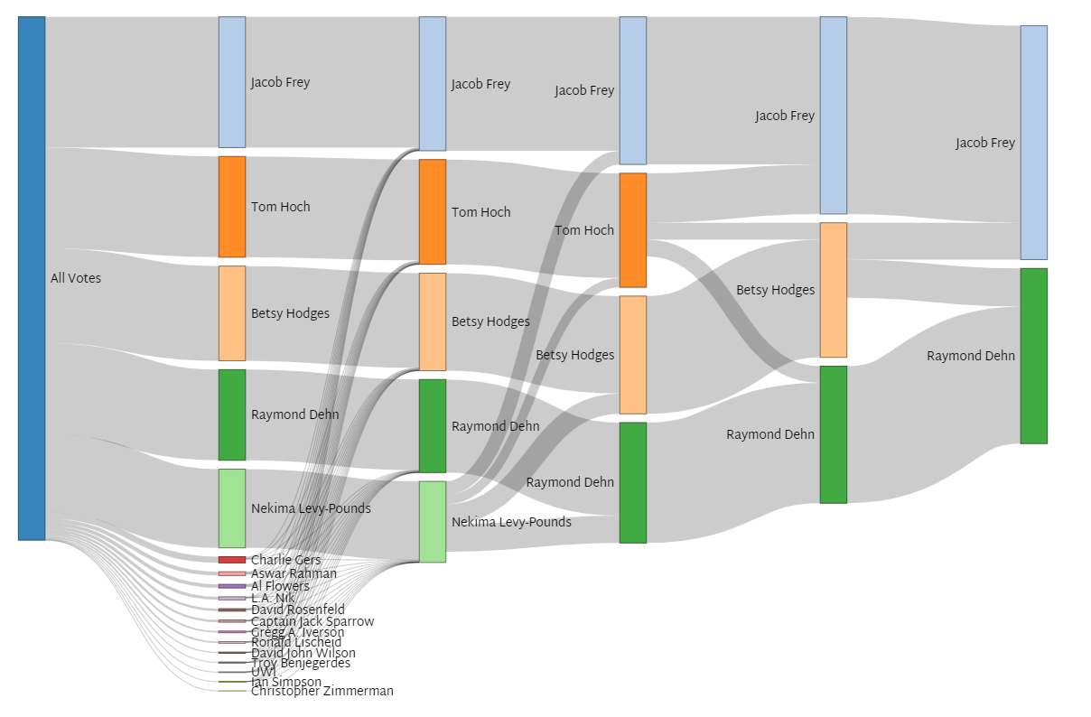
Summary Table
Interactive Summary Sankey Diagram
Exhausted

